Slide 1
Hubspot
Increase sales efficiency with small budget and limited resources

Slide 2

Problem
Human Resources Startup is facing challenges with scaling their business.
Unique product, great sales hires
Limited marketing budget and limited resources
Limited target group’s size
Lack of processes is overwhelming for sales

Slide 3
Focus areas
Automate sales emails and free time for prospecting
Establish sales processes for handling prospects at their different stages
Build sales pipeline to give the team real-time access to progress
Monitor performance weekly and focus on activities with best revenue potential

Slide 4
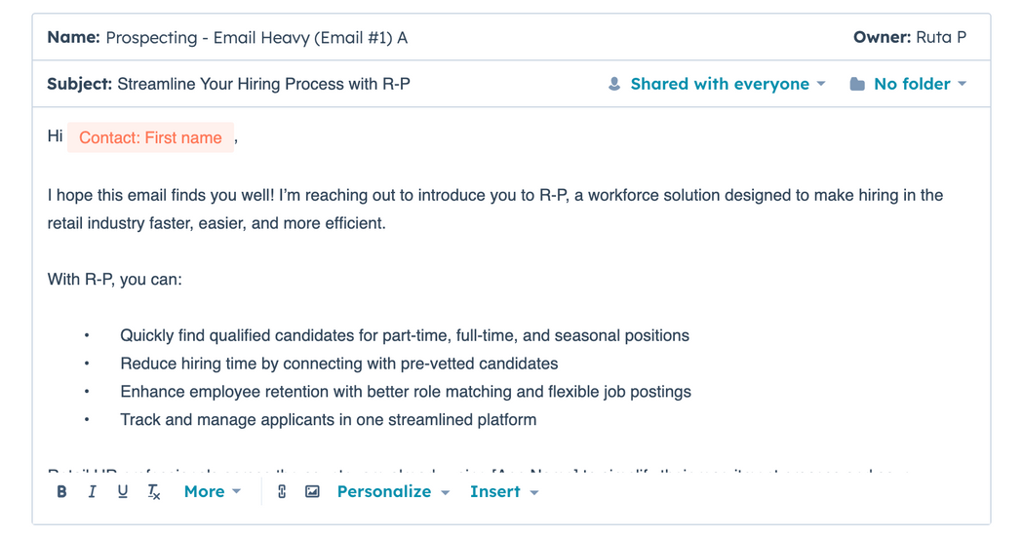
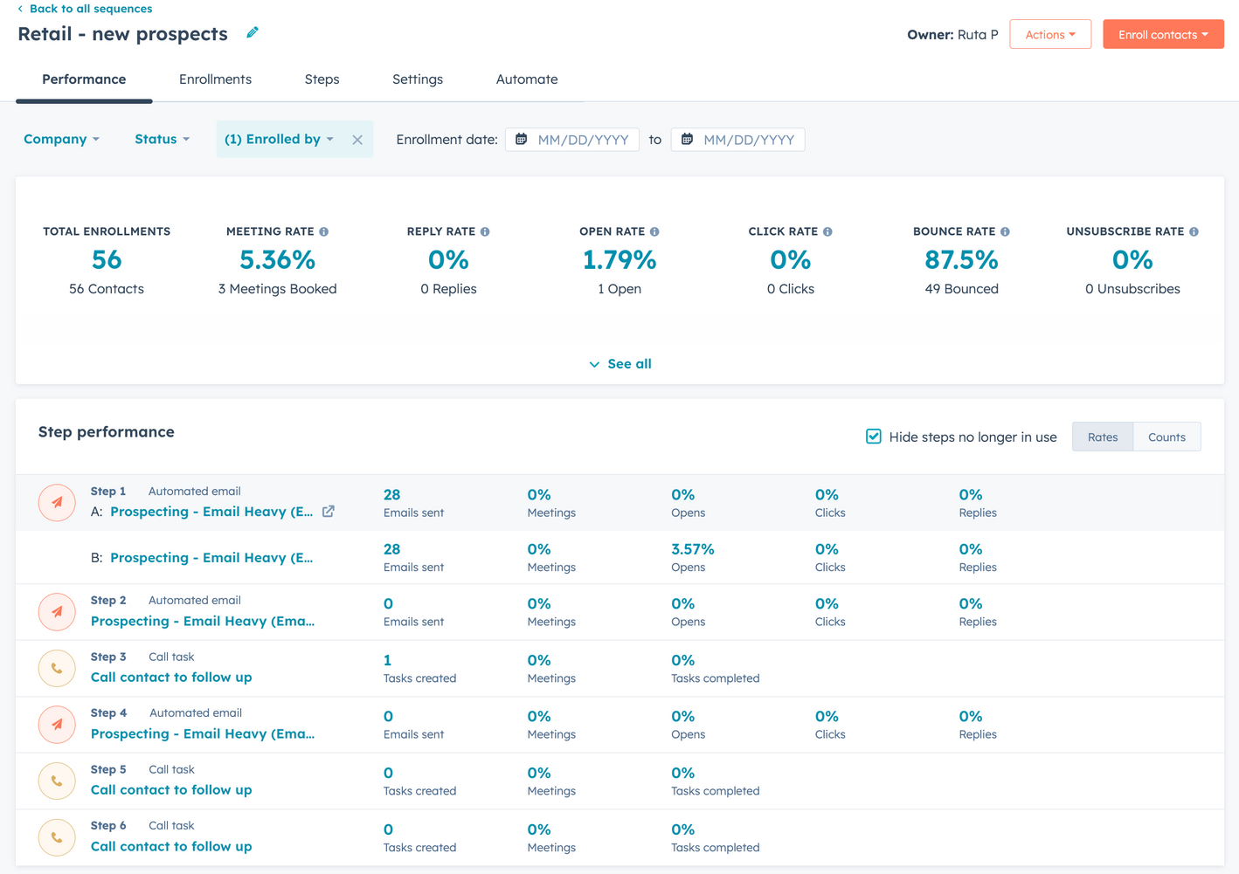

Email sequences
I created sales email sequences for each of the target groups. I monitored email performance weekly and worked closely with sales to improve our messaging.
Metrics
I A/B tested different subject lines and CTAs to come up with the best combinations for increased open rates and engagement. Gathering data on best time/ day was important too - especially when working with different target groups.

Slide 5
Staying on top of porspect’s lifecycle
Working with limited target group meant that we couldn’t afford to loose prospects who were not ready to buy yet. I created workflows and tasks to help sales ensure that didn’t happen
Bad timing
Together with sales we developed a system for tracking our leads with descriptive lead statuses and workflows. We changed “bad timing” to “bad timing - contact in three months”. This outcome automatically triggered a workflow where prospect was sent an automated email in 3 months time after the last contact was made and task was created for sales to follow up.

Slide 6
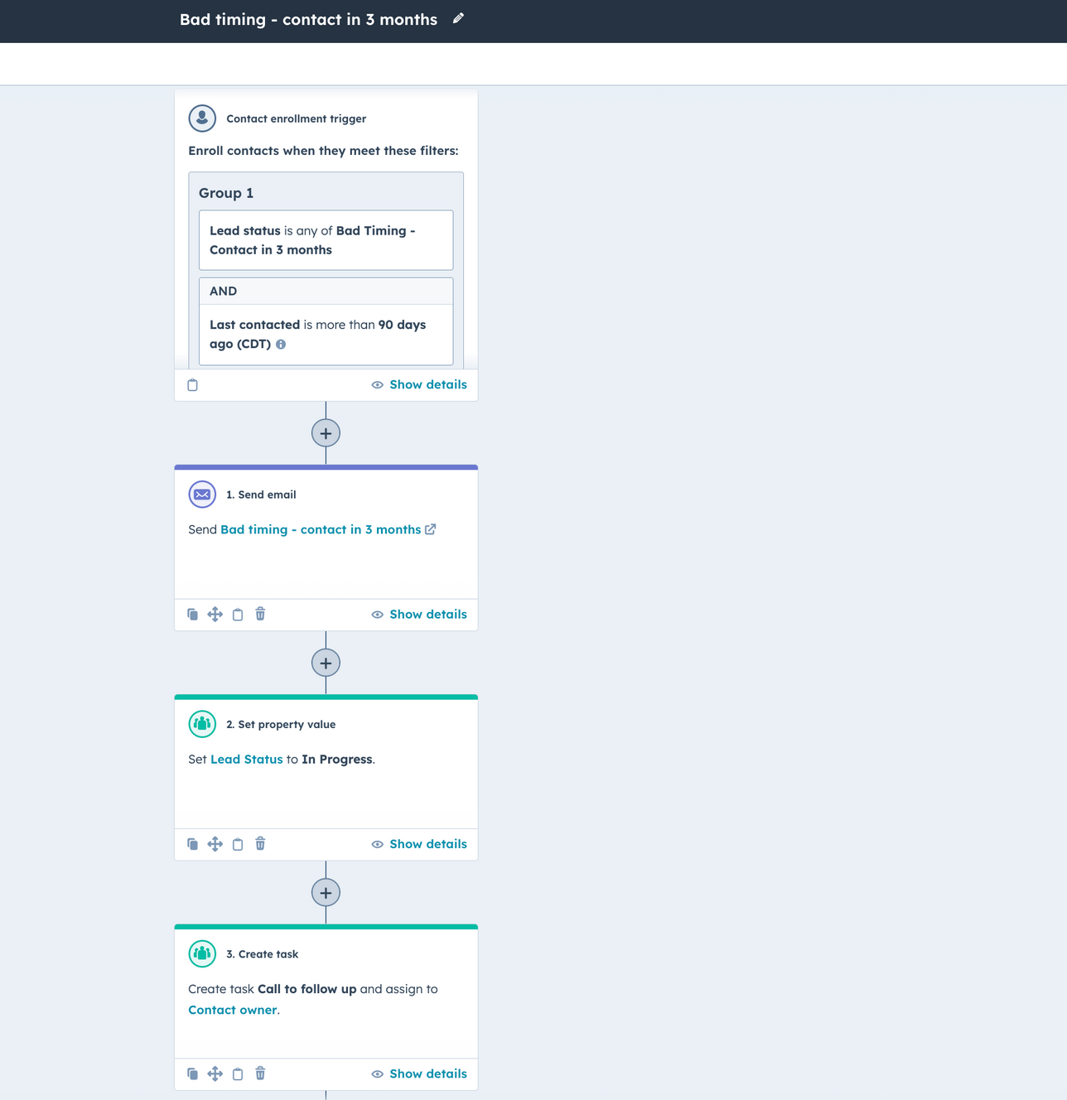
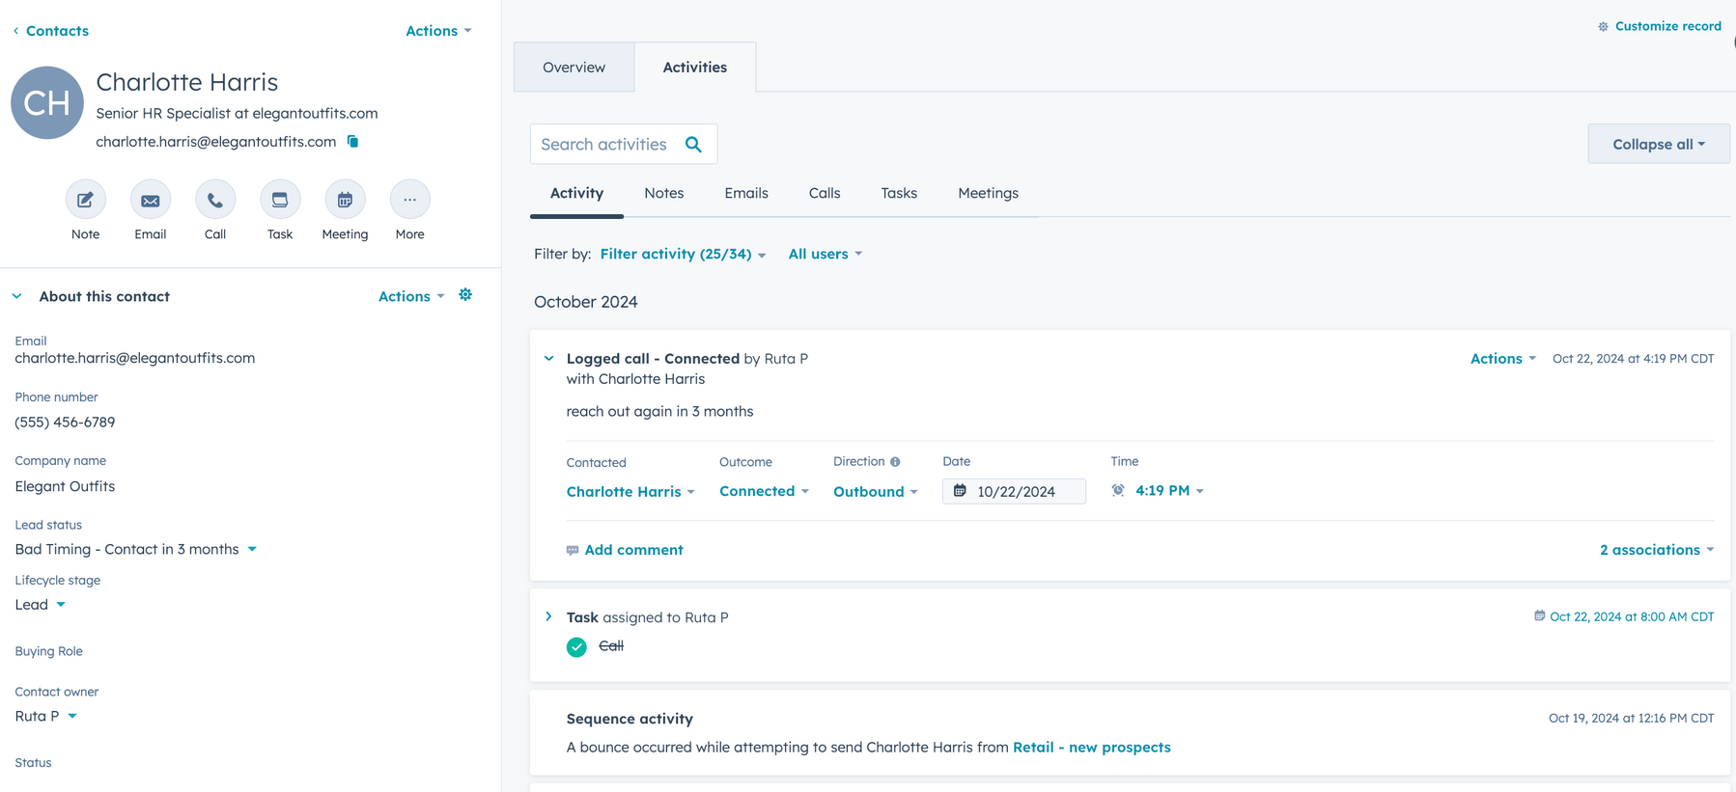

Slide 7
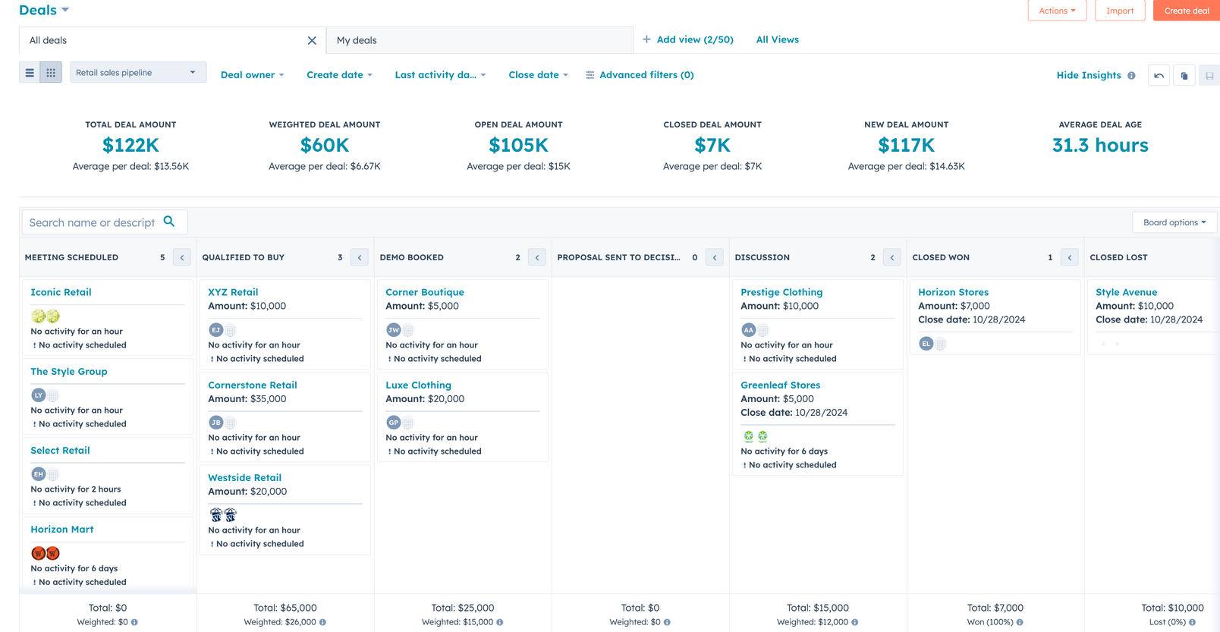
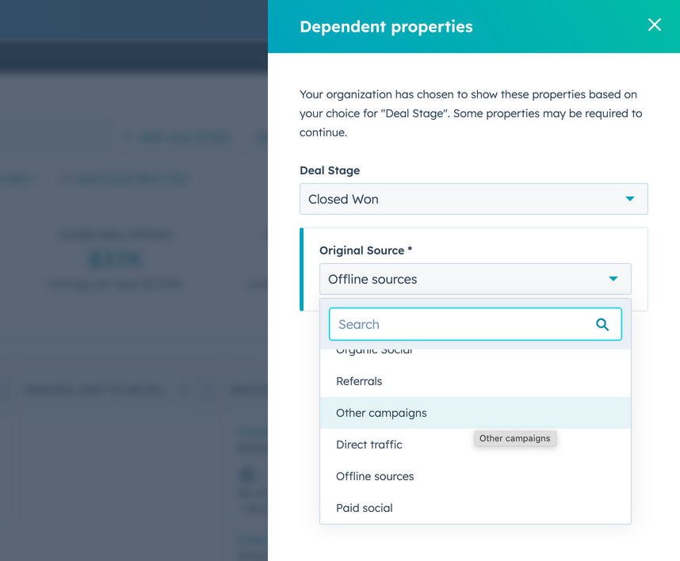
Sales Pipeline
Sales pipeline was crucial tool for monitoring our progress and aligning sales and marketing activities. Each stage had to be applicable to our sales process, and certain conditions had to be met to move prospects further down the pipeline.
Some stages required sales to enter additional information, such as “deal amount” or “lead source” to help us get the necessary data for analysis.

Slide 8
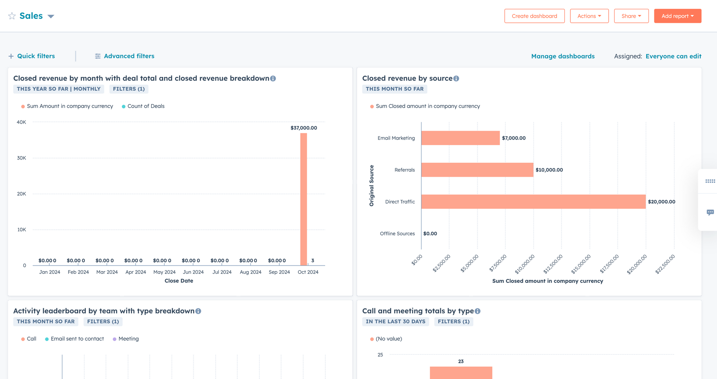

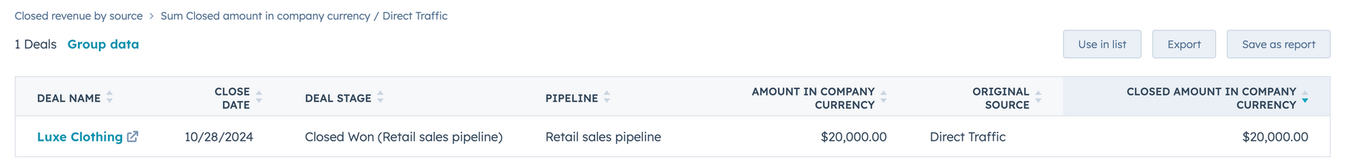
Data for efficient resources allocation
With limited marketing budget, it was crucial for us to invest in activities that would have the best ROI. Monitoring “revenue per lead source” metric helped me plan which marketing activities to invest in.
Connecting our best customers with their lead sources was important information for our stakeholders.

Slide 9

My Hubspot superpowers
Lead management
Sales pipeline
You will get personal about managing your relationships with prospects
Your sales team will have an actionable view on their efforts and real-time data on their progress
Sales and Marketing alignement
Data collection and performance analysis
Your sales and marketing teams will understand each other
You will have factual information about what works and what doesn’t, backed up by data

Slide 10

262-227-1324
Let’s talk!
ruta.puistomaa@gmail.com
linkedin.com/in/ruta-puistomaa/

